Slide 1
Credit Card Approval
By: Krit Patel

Slide 2
Who is this information useful to?
Applicants seeking insight on credit card approval based on their finances.
Management to evaluate the business model.

Slide 3

The source of this dataset is from Kaggle belonging to a UCI Machine Learning Repository.
Dataset contains information regarding Credit Card Applicants and whether or not they got approved.
DATA SOURCE:
Source link

Slide 4
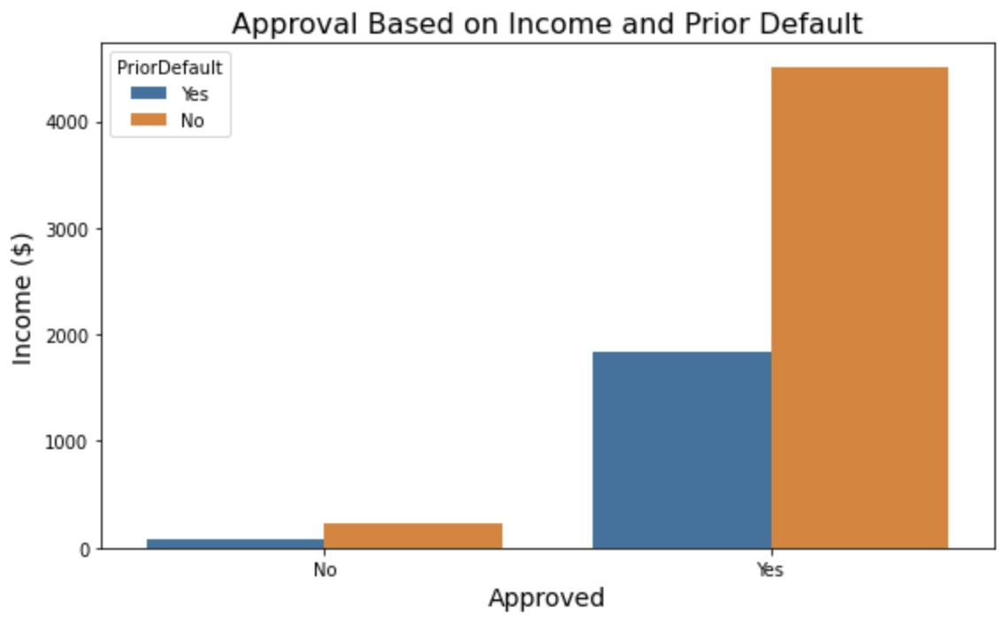
Data Visualization
This barchart indicates that an income of $ 500 or more qualifies an applicant for a credit card regardless of their default status.

Slide 5
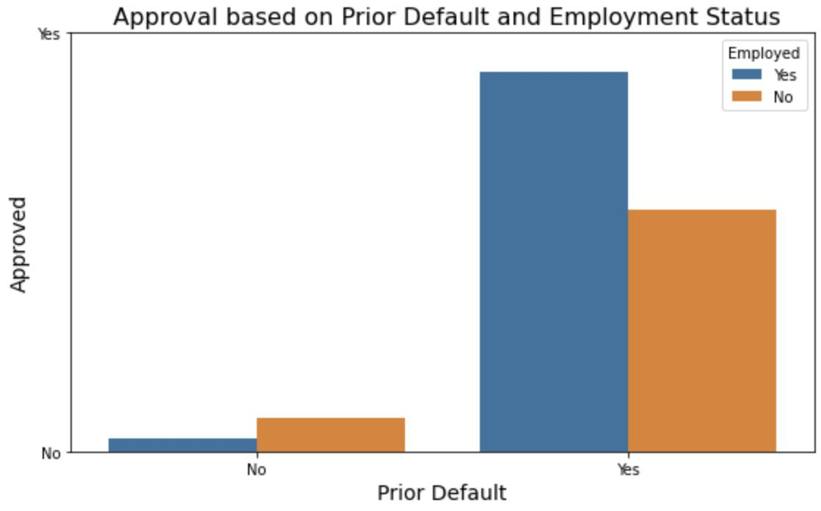
Data Visualization
Applicants with a prior default have a higher chance of approval if they are employed vs unemployed.
Applicants without a prior default have a higher chance of approval if they are unemployed vs employed.

Slide 6
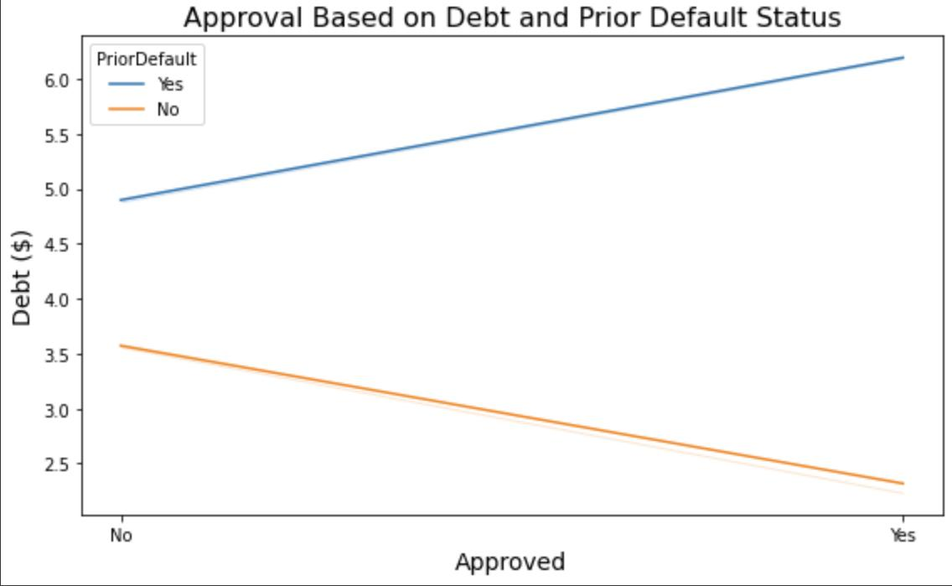
Data Visualization
Applicants with a prior default are more likely to be approved as debt increases.
Applicants without a prior default are more likely to be approved as debt decreases.

Slide 7
Prediction Model Evaluation
Class Balance: 44% of applicants being approved and 56% of applicants
being denied.
The model predicts whether or not a person got approved with 85% accuracy.
7% of the predictions from the model are that an applicant did not get approved when they got approved.
8% of the predictions from the model are that an applicant got approved when they did not get approved.

Slide 8
Final Recommendations
Keep improving the model.
Try different models.
Adding more data would help improve accuracy of this model.

